Slide 1

QUICK SEARCH: AI-POWERED SUMMARIES & RECOMMENDATIONS

Slide 2

Team Details
Branch/Section: IT-A
Team Number: 7
Domain Bucket/Name: Deep Learning
Team Members: Karthik Kolohal (21BD1A1225)
Abhinav Vengala (21BD1A1262)
Kapardhi Kannekanti (21BD1A1224)
Karthikeya V (21BD1A1264)

Slide 3
Introduction
Quicksearch is a web application that uses AI to provide real-time summaries of articles based on user queries while enabling multilingual support in English, Telugu, Hindi, and Kannada.
It utilizes advanced natural language processing techniques, including Google APIs, YAKE for keyword extraction, and Fine-Tuned LLM models, to retrieve and summarize the most relevant content.
The platform incorporates Retrieval-Augmented Generation (RAG) to enhance user experience by allowing follow-up question answering for deeper exploration of topics.
A Streamlit-based frontend delivers a dynamic, user-friendly interface, making Quicksearch intuitive for users to interact with.
The project is designed to help users save time and gain concise, insightful information without navigating through extensive content, providing significant value to researchers, professionals, and the general public.

Slide 4
Key Features of Quicksearch
1. Real-Time Summarization
Provides AI-driven, concise summaries of real-time articles tailored to user queries.
2. Multilingual Support
Allows users to input queries and receive summaries in multiple languages, including English, Telugu, Hindi, and Kannada.
3. Advanced Natural Language Processing
Employs LLM models GPT models and YAKE for keyword extraction to generate relevant and accurate summaries.
4. Retrieval-Augmented Generation (RAG)
Supports follow-up question answering based on summarized content, enabling deeper exploration of topics.
5. Keyword-Based Recommendations
Extracts meaningful keywords from articles and suggests personalized, related content for further exploration.

Slide 5
Software Requirements Specifications
Functional Requirements
Multilingual Input Handling
Real-Time Article Retrieval
Summary Generation
Keyword-Based Recommendations
Interactive UI with Question-Answering Tabs
2. Non-Functional Requirements
Performance
Usability
Reliability
Compatibility
Scalability

Slide 6
Software Requirements Specifications
3. System Requirements
• Operating System: Windows, macOS, or Linux
• Processor: Intel Core i5 or equivalent
• RAM: 8GB DDR4 or higher
• Storage: 256GB SSD or more
• Browser: Chrome, Firefox, or Edge
• Internet Connection: Minimum 2 Mbps
• Display: Full HD Display
4. User Interface Requirements
• Search Input Field
• Summary Display with Related Recommendations
• Question-Answering Tabs
• Customizable Summary Length Options
5. Development Environment
• IDE: VS Code
• Dependencies: Streamlit, Hugging Face, YAKE, FAISS, NLTK

Slide 7
Literature Survey
Real-Time Article Summarization Techniques
Nenkova and McKeown (2011): Explored extractive and abstractive text summarization methods foundational to applications like Quicksearch. Their work focused on condensing lengthy user-generated content while retaining key information, forming the basis for summarization models used in Quicksearch.
Advanced Transformer Models for Summarization
Liu and Lapata (2019): Introduced transformer-based models that advanced the quality and relevance of text summarization. Their ability to handle extensive datasets inspired the integration of modern NLP frameworks in Quicksearch for accurate, real-time summaries.
Retrieval-Augmented Generation (RAG) for Question Answering
Lewis et al. (2020): Proposed the RAG framework, combining transformers and retrieval techniques for real-time question answering. This methodology directly aligns with Quicksearch’s feature of answering queries based on summarized content.

Slide 8
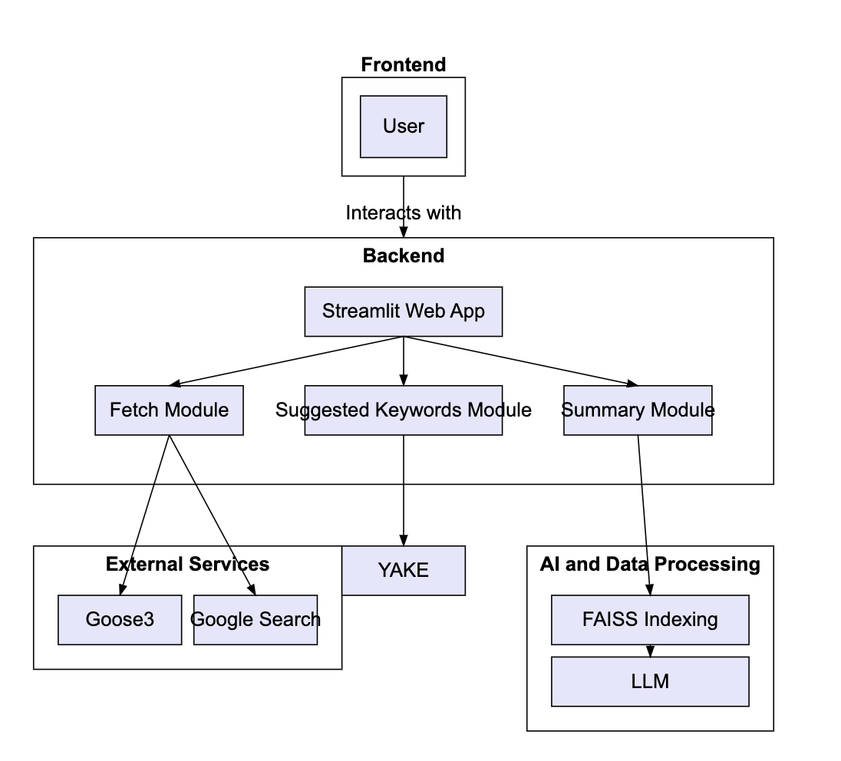
Architecture

Slide 9
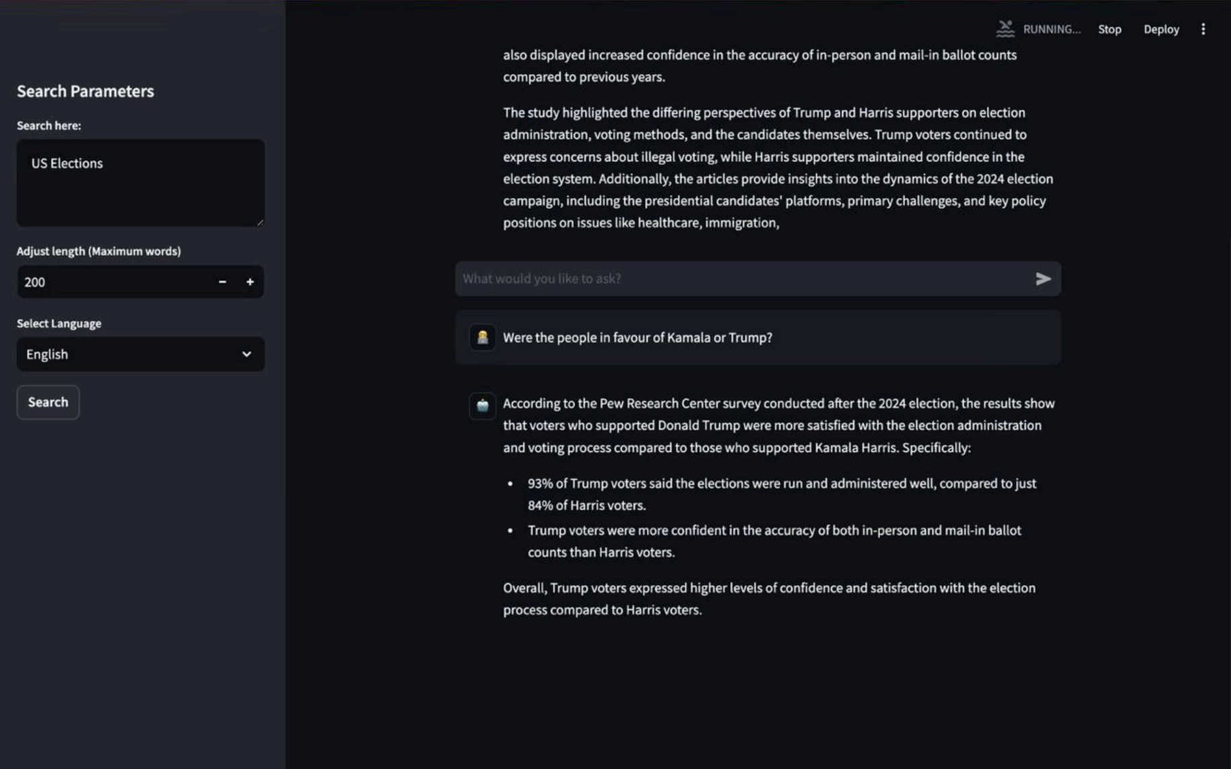

Slide 10
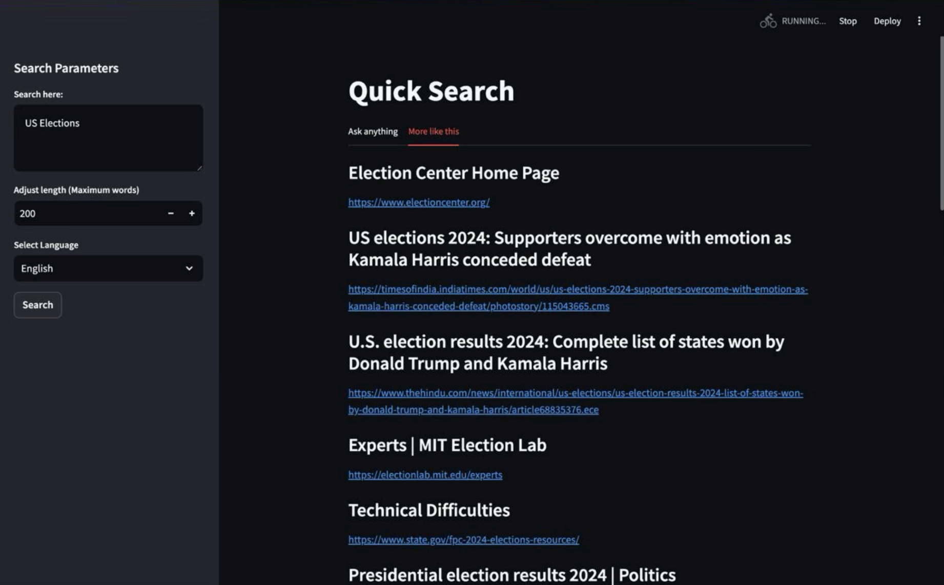

Slide 11
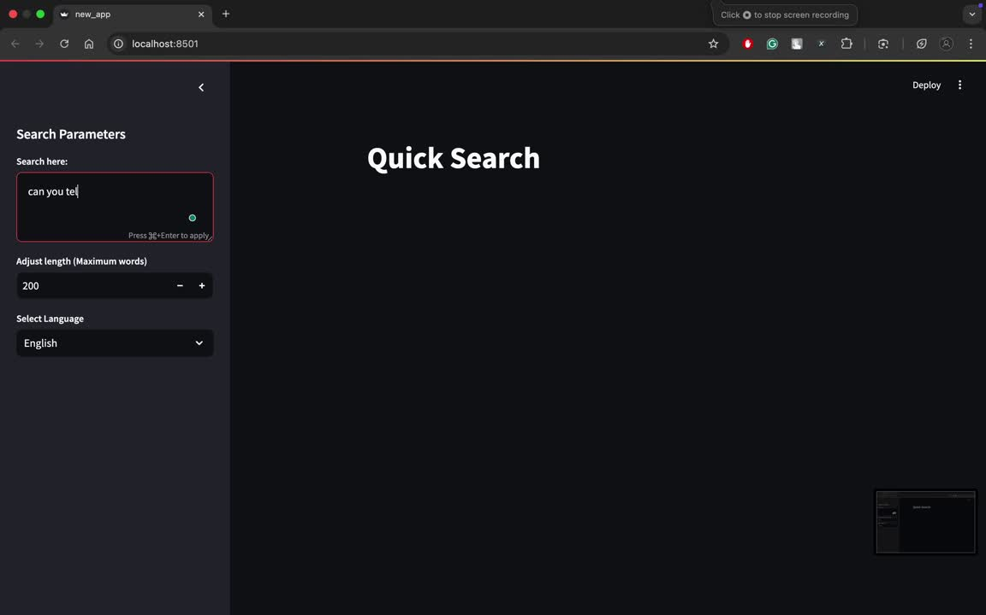
Quick-Demo

